Slide 1
E-R Diagram:
Roles in relationships, Binary vs. Multi-way relationship,
Weak entity
CS 4750
Database Systems
[A. Silberschatz, H. F. Korth, S. Sudarshan, Database System Concepts, Ch.6] [C.M. Ricardo and S.D. Urban, Database Illuminated, Ch.3]

Slide 2
TA Information
Truong Le
Email: sle22@student.gsu.edu
Office hours: Wednesday 12pm-2pm (it can be online or face-to-face at Cubicle 639/640)

Slide 3
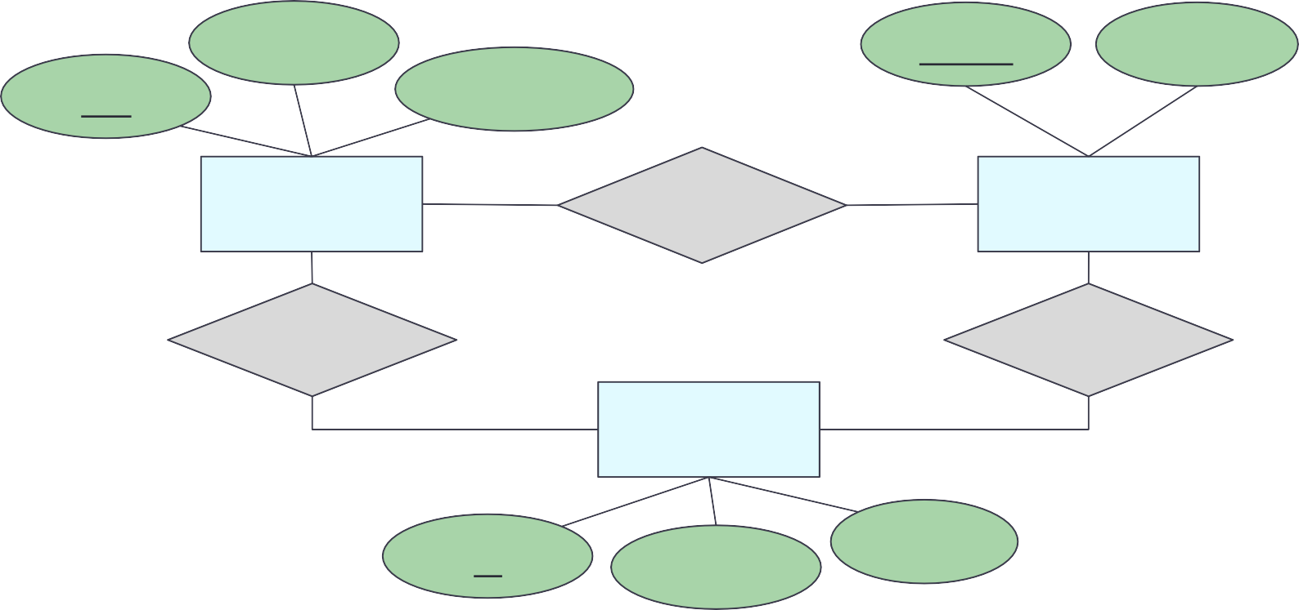
Entity-Relationship Model
E-R diagram – high-level design model representing a database as a collection of entities and relationships among entities
name
name
address
pid
description
product
makes
company
buys
works-for
person
id
address
name

Slide 4
E-R Diagram: Building Blocks
(strong) Entity set
Attribute Relationship
Weak entity
Subclass
is a
Note: colors are not part of E-R Diagram. They simply are used to increase readability.

Slide 5


Entity and Entity Sets
Entity ~an object (thing to keep track to run the business)
Entity set ~a class (~table, a collection of things of the same kind)
Some entity set
examples
Student
Building
Doctor
Treatment
Course
Faculty
Patient
Nurse

Slide 6
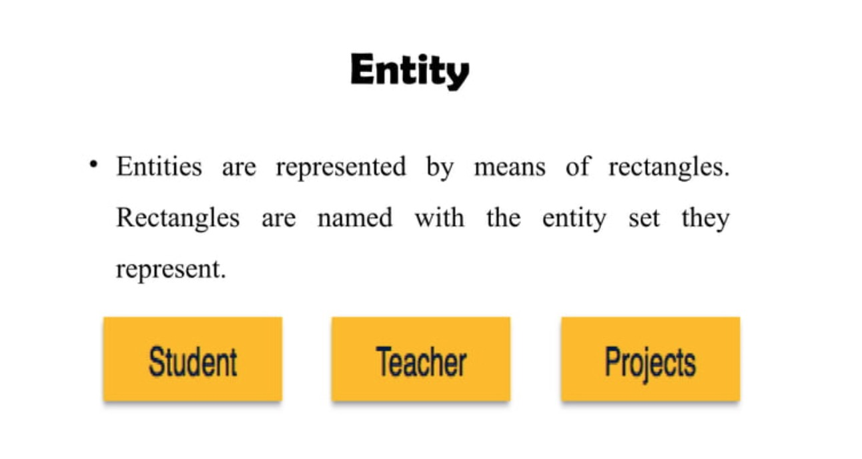

Slide 7
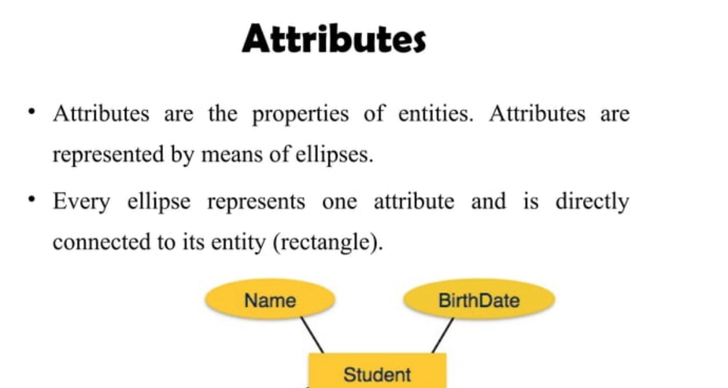

Slide 8


Entity Sets and Attributes
Every entity set should have a primary key
An entity is an object that is distinguishable from other types of objects
person
id
address
name
An attribute has domain specifying acceptable values
Underline indicates that the attribute is part of the primary key
E-R model is a static concept, involving the structure of data and not the operations on data.
Thus, no methods associated with an entity set

Slide 9
Let’s try: Movie-Database
Movies
Movies
Title | Year | Length | Genre
Mickey’s Club House | 1939 | 231 | drama
Awesome Minnie | 1977 | 124 | sciFi
Most wanted | 1992 | 95 | comedy
title
genre
year
length
MovieStars
name | address | gender | birthdate
Mickey | 11 Somewhere, Charlottesville, VA, 22903 | F | 01/01/1911
Minnie | 22 Another place, Fairfax, VA, 22030 | M | 02/02/1912
Donald | 33 Nowhere, Charlottesville, 22911 | F | 03/03/1913
MovieStars
name
birthdate
address
gender
Note: instances do not exist in E-R. These tables are only to help visualize the database being designed.

Slide 10
Relationships
Connections among two or more entity sets
Binary relationships – connections between two entity sets
Multi-way relationships (u-ary) – connections involving more than two entity sets

Slide 11
Cardinality (or Multiplicity)
A binary relationship can connect any member of one of its entity sets to any number of members of the other entity set
One-to-one
One-to-many
Many-to-one
Many-to-many

Slide 12
Cardinality: One-to-One
product company
pid | name | description |  | name | address
11 | Beyblade | … |  | Dreamwork | …
22 | Trolls | … |  | Hashbro | …
… | … | … |  | Nyform | …
person
owns
passport
Arrow pointing to the entity that is constrained to one
Arrow pointing to the entity that is constrained to one
Each passport can be owned by at most one person. Each person can own at most one passport.
“at most one” – Guarantee existence?
Note: instances do not exist in E-R. These tables are only to help visualize the database being designed.

Slide 13
Example
each student has one backpack, and that each backpack belongs to one student.
One person has one passport, and the passport can only be used by one person.
One family lives in one house, and the house contains one family.
One person owns one car, and the car is owned by one person.

Slide 14
Cardinality: One-to-Many
product company
pid | name | description |  | name | address
11 | Beyblade | … |  | Dreamwork | …
22 | Trolls | … |  | Hashbro | …
… | … | … |  | Nyform | …
mother
child
mother of
Arrow pointing to the entity that is constrained to one
Each mother can have many children. Each child has one mother.
“at most one” and “many” – Guarantee existence?
Note: instances do not exist in E-R. These tables are only to help visualize the database being designed.

Slide 15
Example
parent-child relationship
book authors and their books
websites with multiple web pages

Slide 16
Cardinality: Many-to-Many
product company
pid | name | description |  | name | address
11 | Beyblade | … |  | Dreamwork | …
22 | Trolls | … |  | Hashbro | …
… | … | … |  | Nyform | …
product
makes
company
Each product can be made by many companies. Each company can make many products.
“many” – Guarantee existence?
Note: instances do not exist in E-R. These tables are only to help visualize the database being designed.

Slide 17
Example
Students and Courses
Teacher and students
Library books and borrowers

Slide 18
Attributes on Relationships
Relationships can have attributes
The attributes have values only when the relationship occurs
name
name
address
pid
description
product
makes
company
Use dotted line to connect an attribute to the relationship
quantity

Slide 19
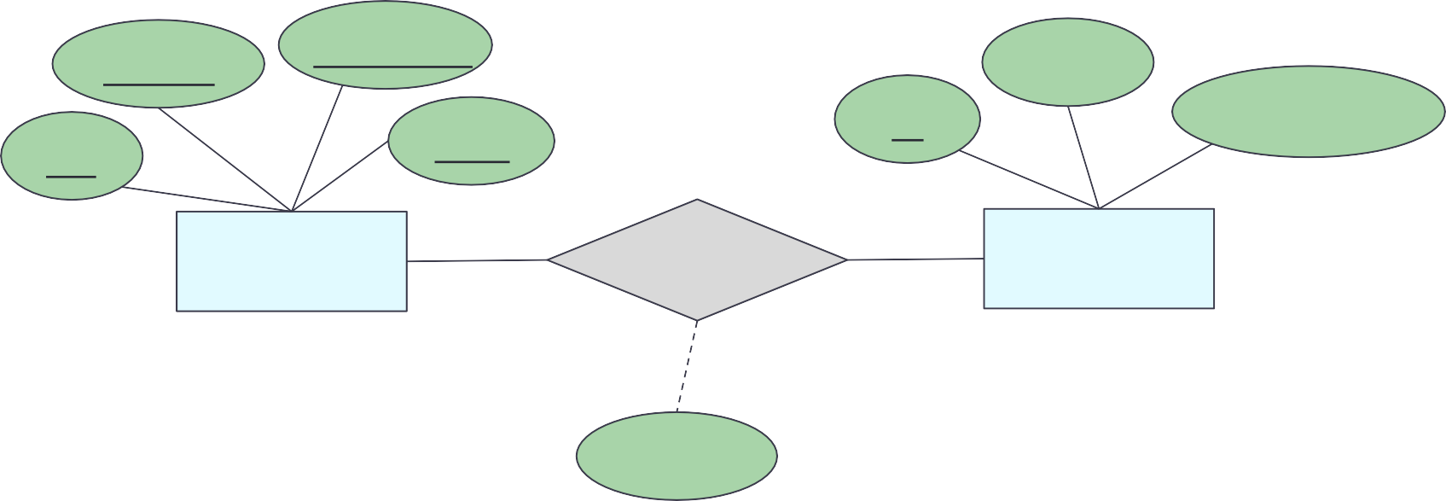
Let’s try: Attributes - Relationships
Interpret the E-R diagram.
sec_id
semester
name
id
total_credit
cid
year
course
takes
student
grade
Each student can take many courses.
Each course can be taken by many students.
A grade exists only when the student takes a course.

Slide 20
Binary vs. Multi-Way Relationships
E-R model makes it convenient to define relationships involving more than two entity sets.
In practice, ternary (3-way) or higher-degree relationships are rare and usually add complexity to the design.
If A, B, and C are sets, a relationship R is a subset of A X B X C
B
R
C
A

Slide 21
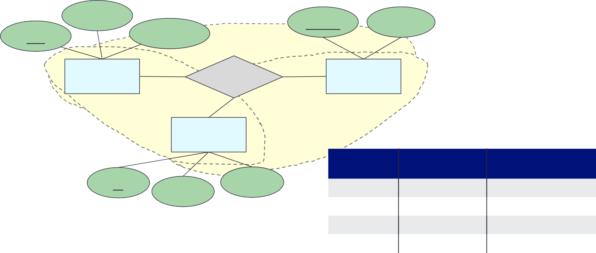
Multi-Way Relationships
name
name
address
pid
description
product
buys
company
person
buys
person.id | product.pid | company.name
11 | p111 | Humpty Inc.
11 | p222 | Humpty Inc.
22 | p111 | Humpty Inc.
22 | p111 | Dumpty Shop
id
name
address
Each (person, product) pair can connect to many companies. Each (person, company) pair can connect to many products. Each (company, product) pair can connect to many persons.
Note: instances do not exist in E-R. These tables are only to help visualize the database being designed.

Slide 22
Multiway Relationships
How do we model a purchase relationship between buyers,
products and stores?
Product
Purchase
Store
Person

Slide 23
Roles in Relationships
What if we need an entity set twice in one relationship?
Product
Purchase
Store
Person
Person
?
Salesperson
Buyer

Slide 24
Roles in Relationships
Label the edges to indicate the roles
Collapse the two entity sets into one
Product
Purchase
Store
Salesperson
Buyer
Person

Slide 25
Example
Design a database for a bank including information about customers and their accounts.
Information about a customer includes their name, address, phone, and Social Security number.
Accounts have numbers, types (saving, checking) and balances. Also record the customers who own accounts.
Draw the E/R diagram for this database. Be sure to include arrows where appropriate, to indicate the multiplicity of a relationship.
Notes:
4.1.1

Slide 26
Example
Design a genealogy database with one entity set: people. The information to record about persons includes their name, social security number. The people entity set has three different roles: mother, father and children.

Slide 27
E-R Diagram: Building Blocks
revisit
(strong) Entity set
Attribute Relationship
Weak entity
Subclass
is a
Note: colors are not part of E-R Diagram. They simply are used to increase readability.

Slide 28


Strong and Weak Entity Sets
Strong entity set
What we have been discussing so far
Entities can be identified by the values of their attributes (a primary key)
A weak entity’s existence depends on its strong entity
Weak entity set
No primary key → cannot be identified by their attributes
To identify, need a combination of their attributes (“discriminator”) and the relationship they have with another entity set (“identifying relationship”)
If X and Y are entities and each instance of Y must have a corresponding instance of X, Y is “existence dependent” on X
→ Y is a weak entity, and X is its strong entity
→ Y must have total participation in its relationship set with X

Slide 29

Weak Entity Set
By definition, there must be total participation between the weak entity set and its identifying relationship “existence dependency”
Discriminator
Total participation
payment_number
PantherID
Name
date
Payment
Tuition Fee Payment
Student
Strong entity set
payment_amount
Weak entity set
Identifying relationship
Does not have sufficient attributes to form a primary key.
Depends on the strong entity set it is associated with.
Needs a discriminator and a primary key of the strong entity set.

Slide 30
Weak Entity Set
Entity sets are weak when their key attributes come from other classes to which they are related
This happens if:
part-of hierarchies
Diamond with double border
If an attribute of it is a part of the key, underline it
Loan Number
ssn
Amount
Payment Number
Date
)
Loan Payment
Payment
Officer

Slide 31
Weak Entity Set
The entity set E is said to be weak if
in order to identify entities of E uniquely, we need to follow one or more many-one relationships from E and include the key of the related entities from the owner entity sets: one owner, many weak entities
name
ssn
lot
cost
pname
age
Employees
)
Policy
Dependents

Slide 32
Let’s try: Weak Entity Set
What can be concluded from the following E-R diagram?
hw_number
c_number
course
title
due_date
homework
have
total_scores
Homework cannot exist without a course. Every homework must belong to a single class. A course can have many homework.
Different courses may have the same homework number.
To identify a homework, we need c_number and hw_number.

Slide 33
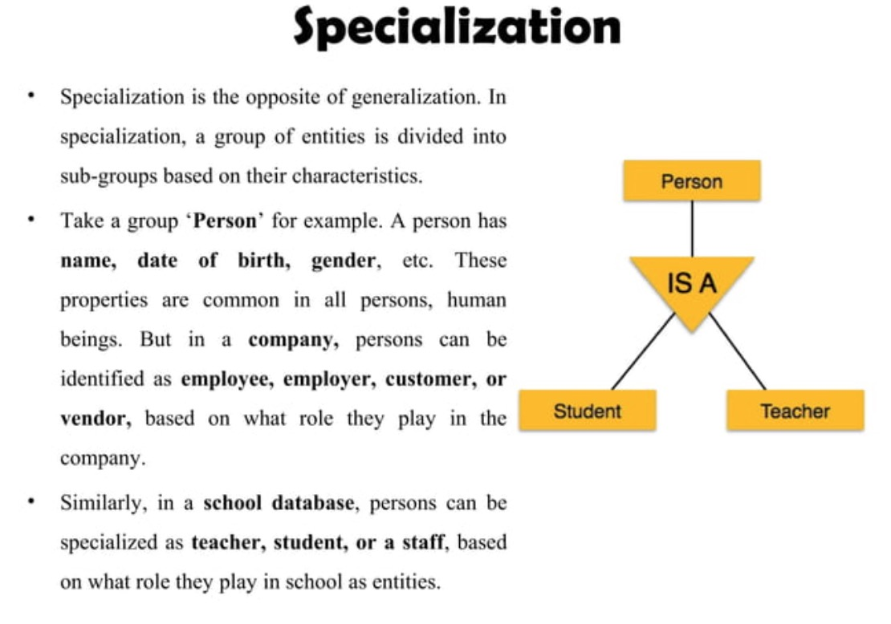
Subclass

Slide 34
Inheritance in the E/R Model Subclasses(subentities)
Subclass
Assume subclasses form a tree
No multiple inheritance
Isa triangles indicate the subclass relationship
Point to the superclass
Superclass contains all common attributes
Subclasses contain specific attributes.

Slide 35
Inheritance in the E/R Model Subclasses(subentities)
Subclass
Entity set containing special properties not associated with all members of the set
Subclass = special case
= with its own special properties and/or relationships
Example: Products
Software products
Educational products
Let us suppose that in addition to all the properties (attributes and relationships) of products, Software products also have the other attributes, e.g. platform

Slide 36
Subclass
price
name
category
Product
isa
isa
Software Product
Educational Product
platforms
age group

Slide 37
price
name
category
type
How to keep subclasstype
Supertype may have a discriminator attribute which indicates subtype
Product
isa
isa
Software Product
Educational Product
Software Product
platforms
age group
platforms

Slide 38
Advantages of IsA
price
name
category
Can create a more concise and readable E-R diagram
Attributes common to different entity sets need not be repeated
They can be grouped in one place as attributes of supertype
Attributes of (sibling) subtypes can be different
Product
isa
isa
Software Product
Educational Product
Software Product
platforms
age group
platforms

Slide 39

Questions?

Slide 40
Example
Design a database for a bank including information about customers and their accounts.
Information about a customer includes their name, address, phone, and Social Security number.
Accounts have numbers, types (saving, checking) and balances. Also record the customer(s) who own an account.
Draw the E/R diagram for this database. Be sure to include arrows where appropriate, to indicate the multiplicity of a relationship.
Notes:
4.1.1

Slide 41
Example cont.
Change your diagram so Saving account has interest rate and checking account has overdraft amount.
Further change your diagram so a customer can have only one account
Change your original diagram so that a customer can have a set of address (which are street-city-state triples) and a set of phones. Remember that we do not allow attributes to have non-primitive types, such as sets, in the E/R model.

Slide 42
Wrap-Up
Roles in Relationships
Relationships: binary, u-ary
Weak entity
Subclassing

